Slide 1

IBM Cognos Analytics Dashboard On Coffee Reviews
Presented By:
Adelly karthik(18UK1A0561)

Slide 2
OUTLINE
INTRODUCTION
OBJECTIVE
IBM CLOUD
IBM CONGOS ANALYTICS
WORKING WITH THE DATASET
DATA VISUALIZATION CHARTS
CREATING DASHBOARD
EXPORT THE ANALYSIS
CONCLUSION

Slide 3
INTRODUCTION
Coffee is an integral and pervasive aspect of hospitality and is part of many, if not most, travel and tourism experiences. Coffee consuming, exhibited through coffee shops, is a resource for the development of coffee-related tourism.
In regards to attracting more customers and to offer a strong value proposition, coffee shops must be accessible for all, barrier- free and implement the concept of accessible tourism.There were three characterisics that were more important to customers than the rest
Unique flavour
Body or mouth feel
Finish or aftertaste
Coffee shop, considered the third most important place after home Many costumers like the experience of trying something new and therefore enjoy coffees with unique flavours

Slide 4
OBJECTIVE
Development of customer-relationship:
Coffee shop, considered the third most important place after home
The purpose of this coffee review is that to get feedback from the customers on what quality of coffee and flavour meant to them
The overall project purpose is that we will be analysing some important visualizations ,creating a dashboard on the basis of coffee shop and flavour reviews and by going through these we will get most of the insight of coffee reviews in India.
By the end of this project you will :
Know fundamental concepts and can work on IBM Congos Analytics.
Gain a broad understanding of plotting different graphs.
Able to create meaningful dashboards

Slide 5
DATA
IBM congos analytics dashboard on coffee reviews
It consists of three datasets:
Reviews - this contains all of the reviews for each of the products. Includes rating and sentiment score.
Products - this is information about each of our products. Includes product_id, name, and unit price.
Keywords - this contains keywords generated from product reviews

Slide 6
Process for data extraction The process will be
⦁
⦁
⦁
Launch the watson discovery
Create a new datacollection
Add keyword enrichment in the enrich feild tab present in the watson
discovery
where remaining enrichments aready has been leisted by default
⦁ Select all 998 json review files located in the data/coffee_reviews directory and upload it into collection

Slide 7
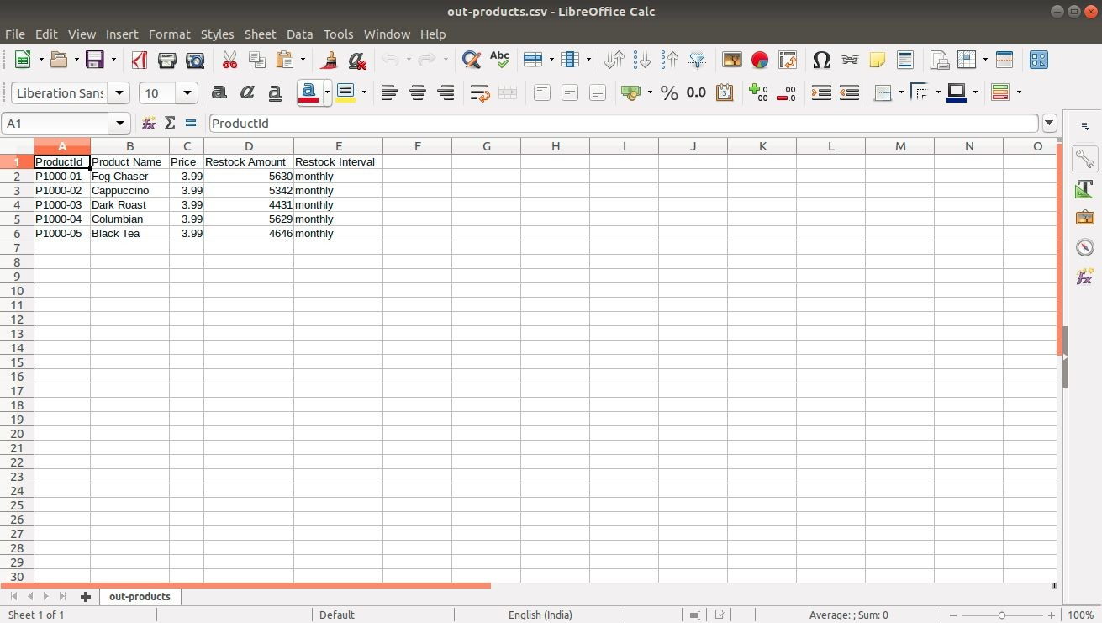
Products
It has 6 data points(rows)and 5 feautures(columns)

Slide 8
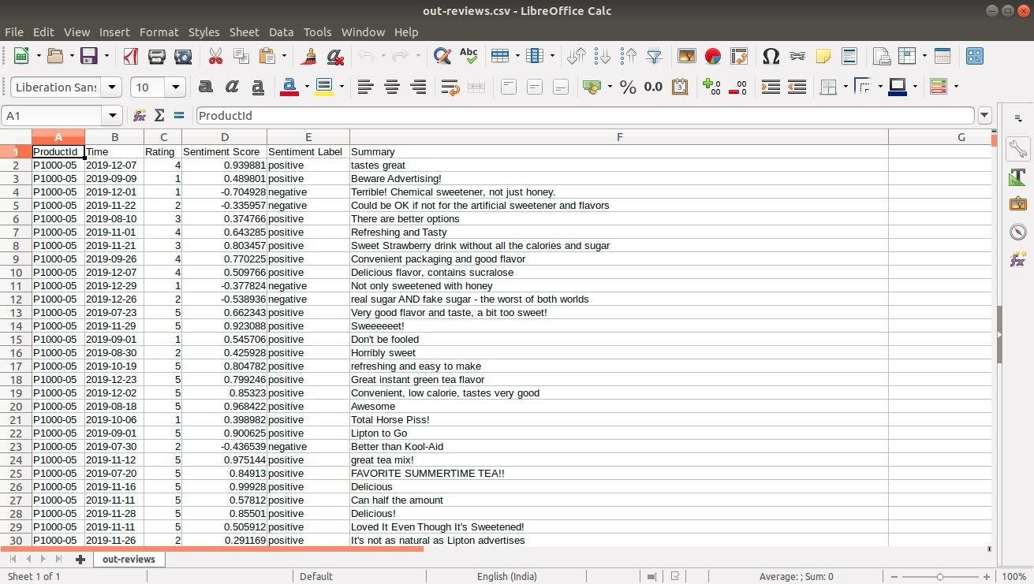
Reviews
It has 999 data points(rows)and 6 features(columns)describing the results of coffee review

Slide 9
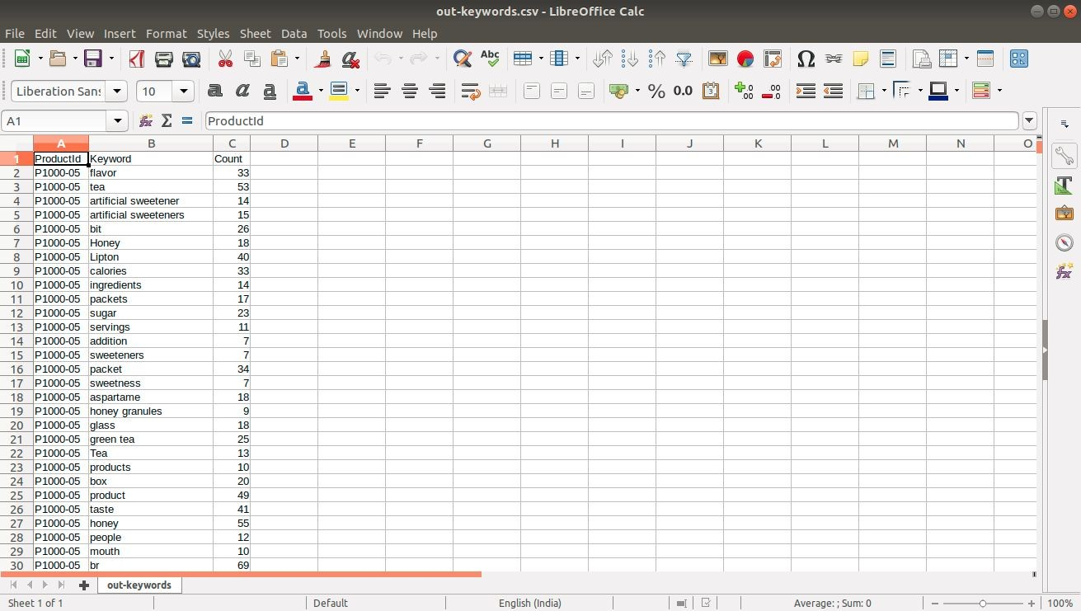
Keywords
It has 998 data points(rows) and 3 feautures(columns)

Slide 10
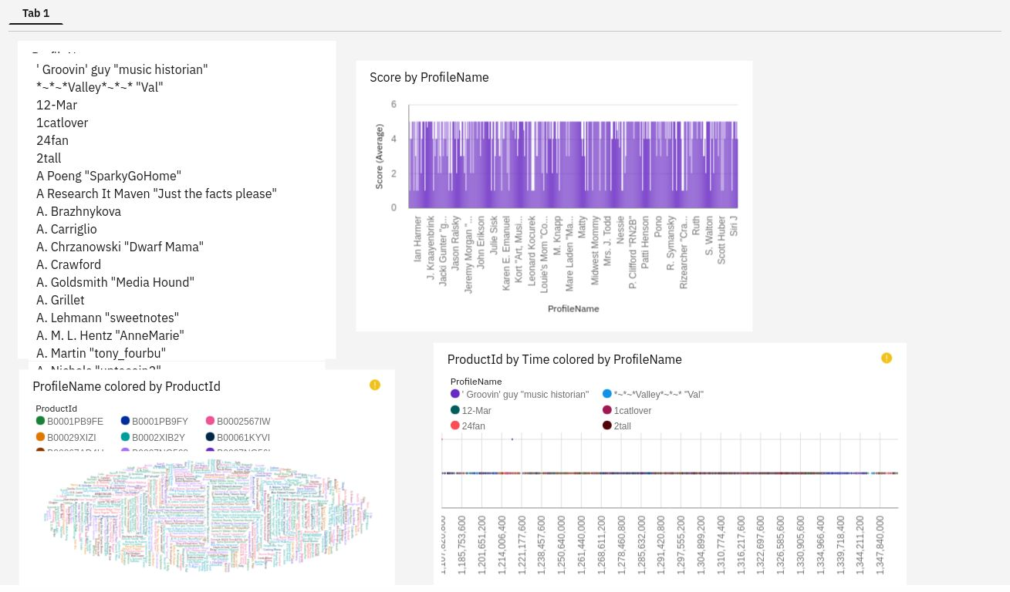
DATA
In addition to the previous datasets we created another dashboard on 1000 reviews

Slide 11
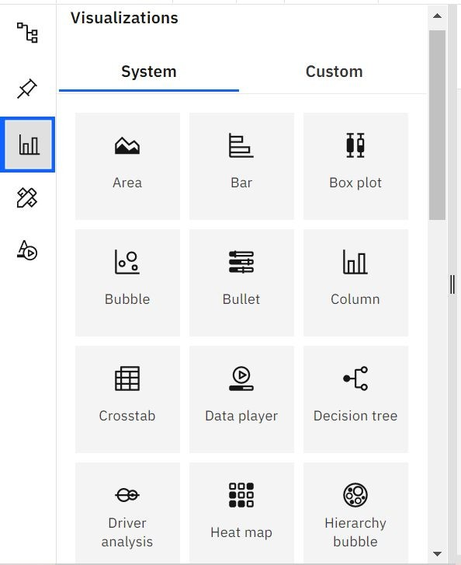
DATA VISUALIZATION
Data visualization is where a given dataset is presented in a graphical format.
It helps the detection of patterns, trends and correlations that might go and detected in test based data.
Using the coffee reviews dataset ,we plan to create various graphs and charts to highlet the insights and visualizations.
To visualize the dataset we need IBM Cognos Analytics Dashboard.
This dashboard contains different visualization such as BAR,AREA,BUBBLE,COLUMN,PIE

Slide 12
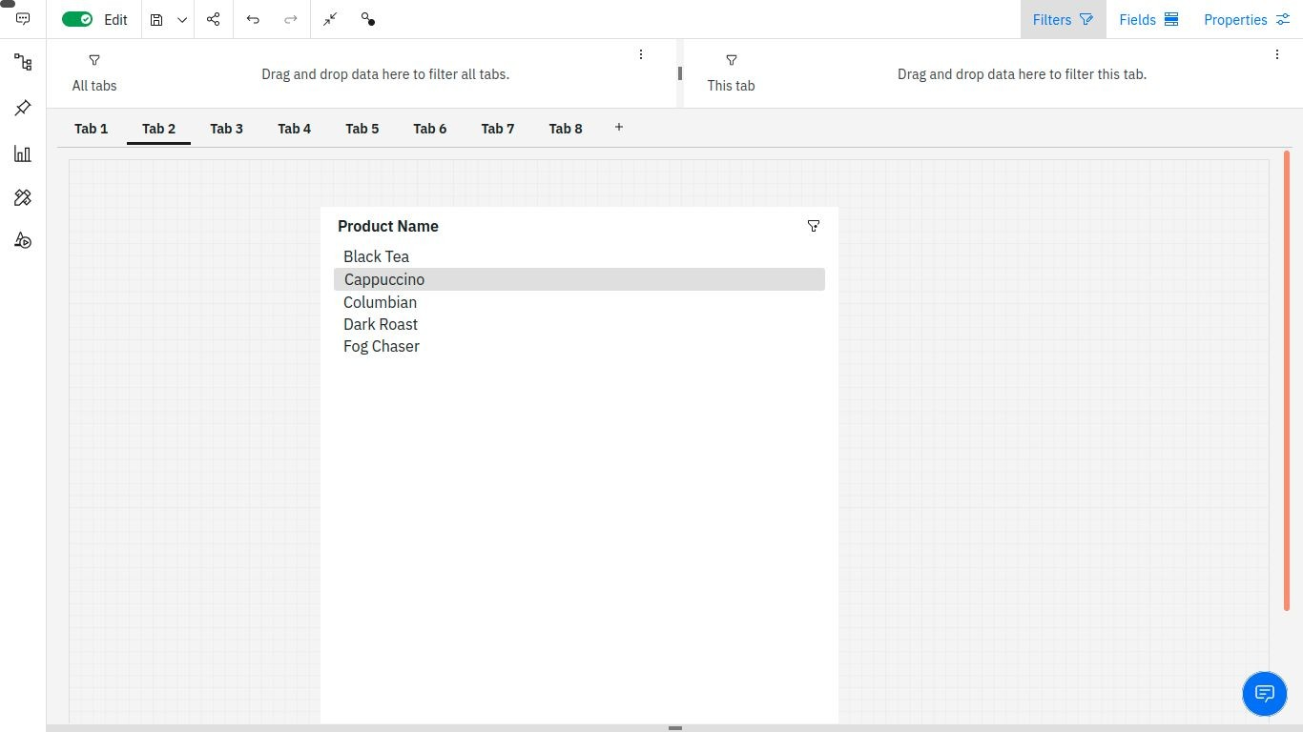
DATA VISUALIZATION CHARTS
Products list box:

Slide 13
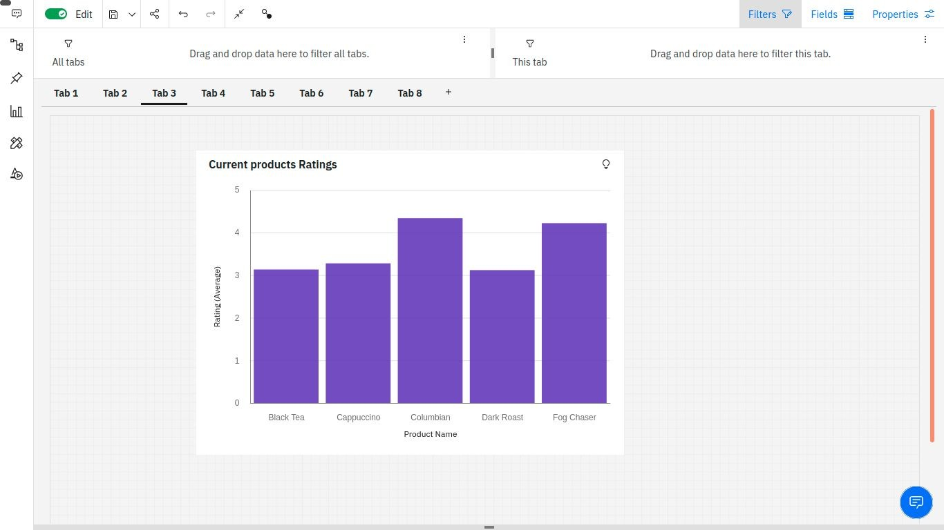
DATA VISUALIZATION CHARTS
Current product ratings:

Slide 14
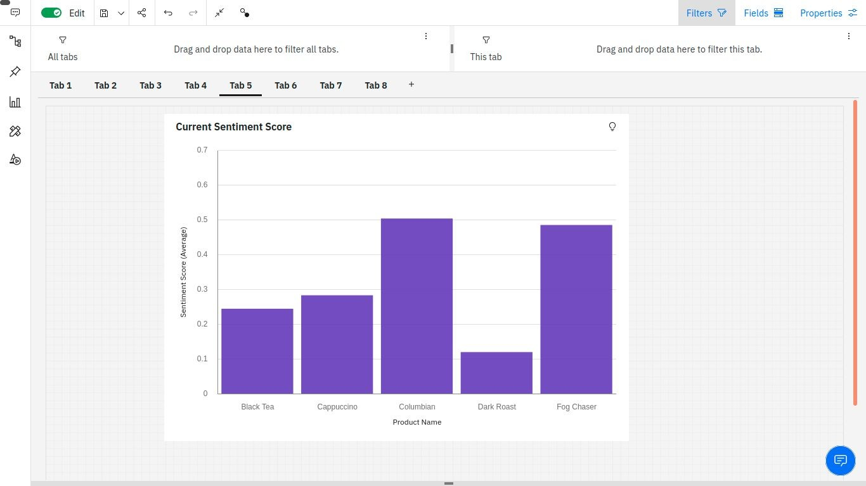
DATA VISUALIZATION CHARTS
Current product sentiment:

Slide 15
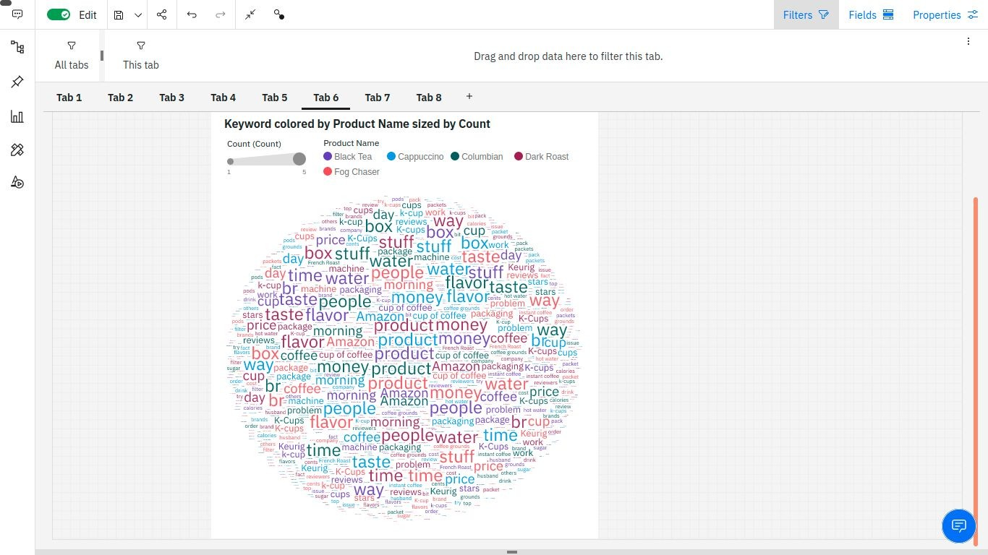
DATA VISUALIZATION CHARTS
Keyword colored by product name sized by count:

Slide 16
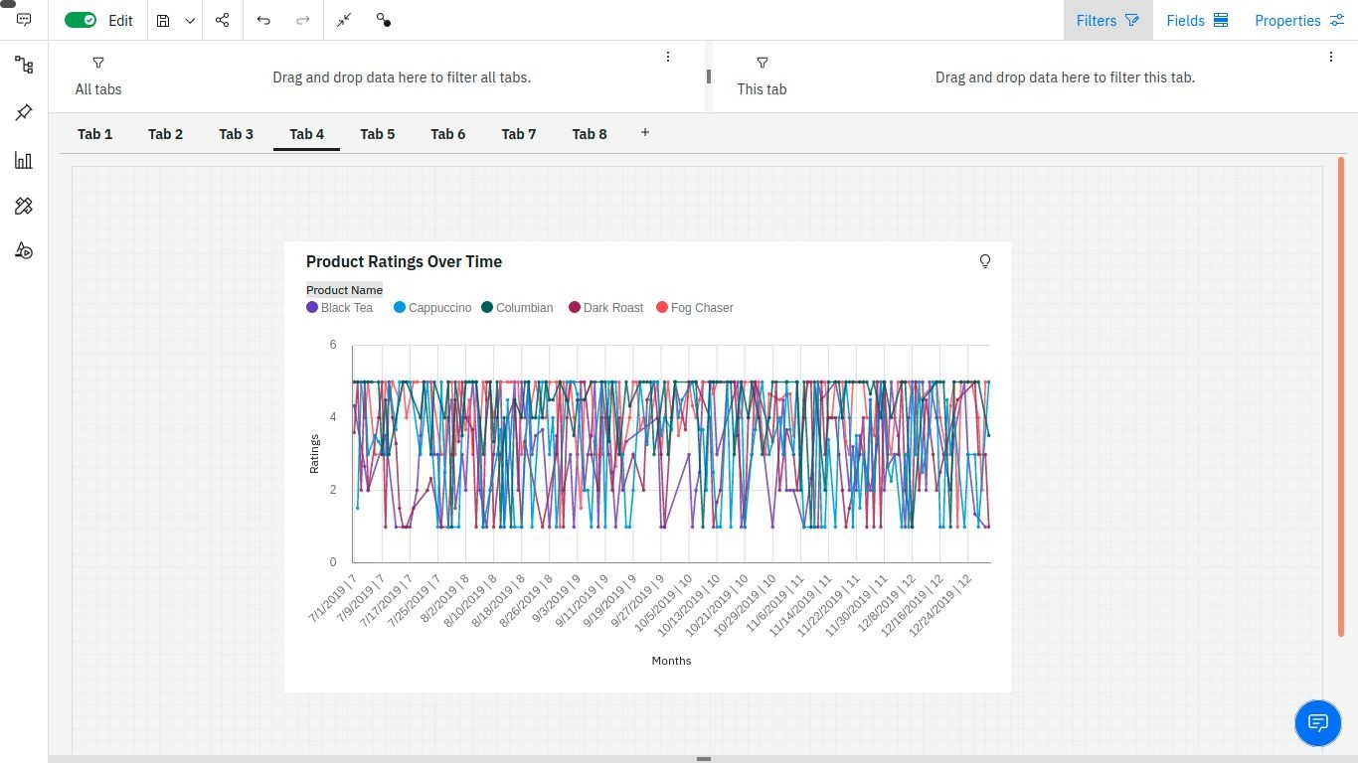
DATA VISUALIZATION CHARTS
Product ratings over time:

Slide 17
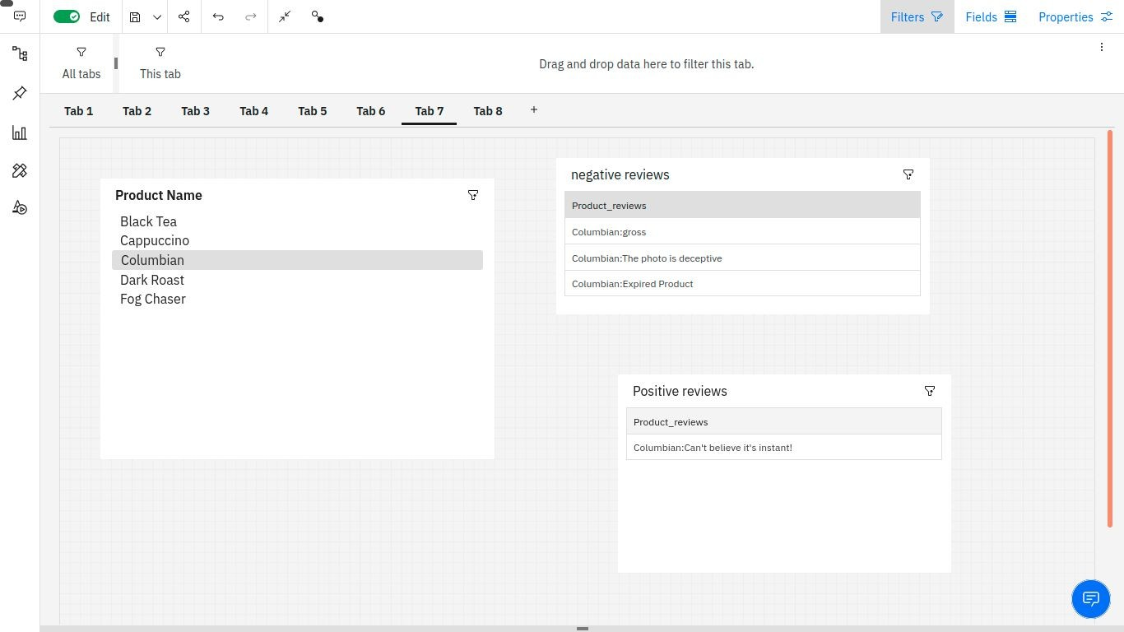
DATA VISUALIZATION CHARTS
Product reviews(positive and negative):

Slide 18
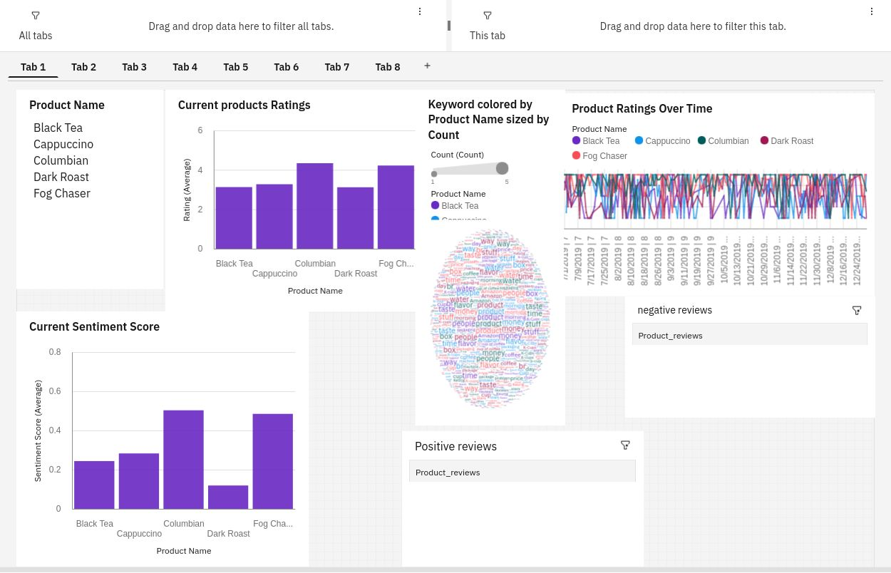
DASHBOARD CREATION:
Once you have created views on different tabs in cognos analytics,you can pull them into a dashboard

Slide 19
SOFTWARE REQUIREMENTS:
IBM Congo’s Analytics Dashboard
IBM Account
Visualization tools: List, Column, Wordcount, Line graph

Slide 20
ADVANTAGES:
lowercosts--reduces maintanence due to complete report coverage and a zero footprint environment
Faster results—shortens reporting time due to seamless integration and adaptive authoring
Improved decision making—reports and dashboards present data in easily-understood formats
Ability to work with data using familiar business terms

Slide 21
DISADVANTAGES:
Total cost of ownership(TCO)is more significant than other tools
Investments in cognos R&D by IBM is declining
⦁ Wont work smoothly with large data sets having many parameters
Cross-browser compatibility is often problematic

Slide 22
CONCLUSION:
In this project we have presented that we will be analyzing some important visualizations, creating a dashboard and by going through these we will get most of the insights of coffee reviews
By the end of this project you will :
know fundamental concepts and can work on IBM Cognos Analytics.
Gain a broad understanding of plotting different graphs.
Able to create meaningful dashboards

Slide 23
Thank you

